Slide 1

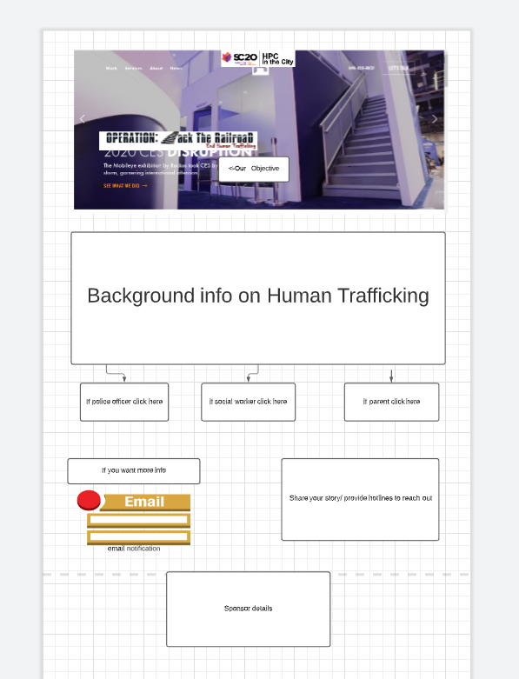
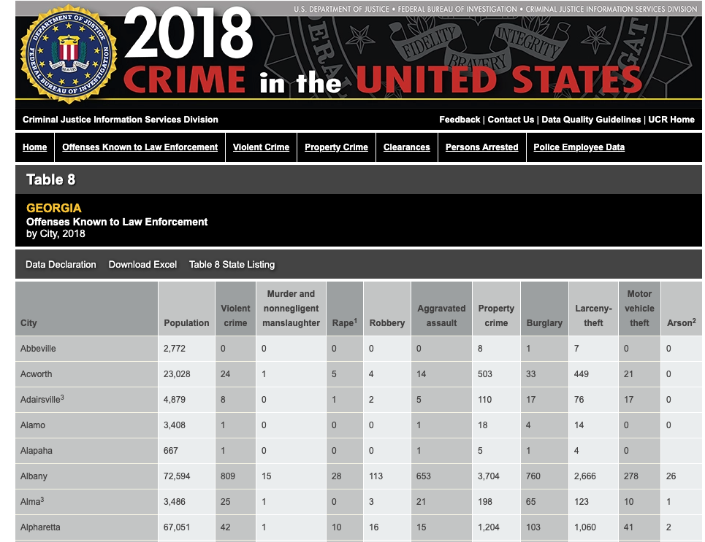


Mission: Get UI and data sorted
Tasks needed:
Develop UI using HTML, JavaScript, Css and following our LucidChart design
Normalize FBI crime data, using Jupyter Notebook on CloudyCluster

Slide 2

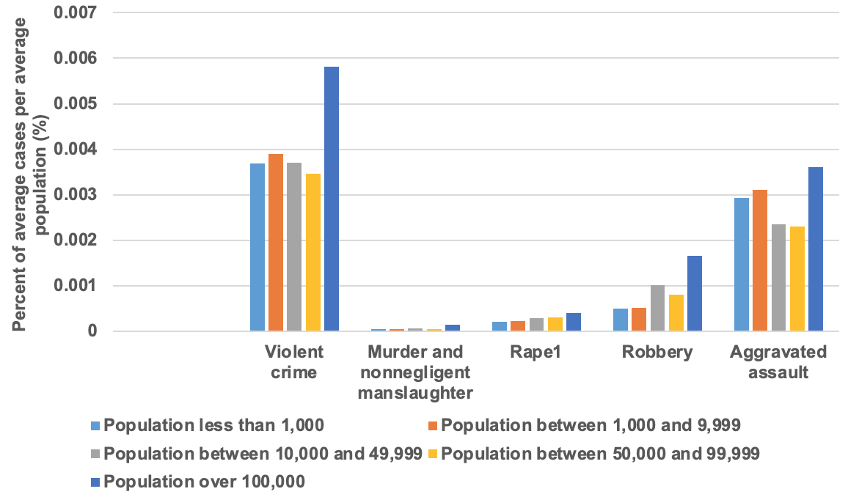
Data set
What: Data revolving the Cities of Georgia as of 2018
How: We will be using this data set in our Operation End Human Trafficking by using incidents that correlate to Human Trafficking such as Rape, Crime, and Violent Crimes.
Where:https://ucr.fbi.gov/crime-in-the-u.s/2018/crime-in-the-u.s.-2018/tables/ta ble-8/table-8-state-cuts/georgi a.xls
Why: We will be using these statistics since actual data on human trafficking is kept a secret by top officials, and as so with these numbers we can visually demonstrate

Slide 3







Our Mission: Create a web application to help law enforcement agents, social workers, and parents END human trafficking by identifying high-risk locations in Atlanta
Ana
Leonardo
Hamza
Kassomou
Phiwat
Klomkaew
Rich Asay
Kyanie
Waters

